Slide 1


JavaScript
the
Stack
Adrian Pomilio / @adrianpomilio / www.pomil.io

Slide 2

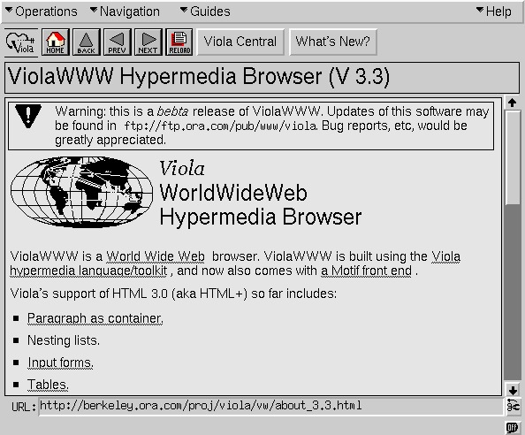
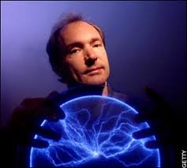
Notes:
The good old days

Slide 3

Notes:
Now the battle continues

Slide 4

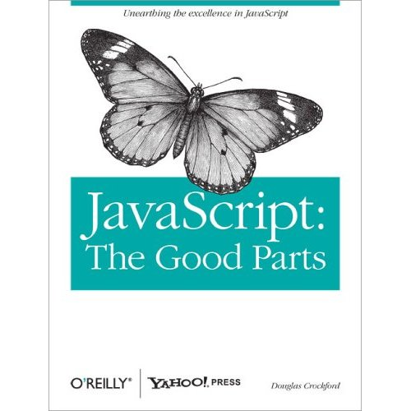
Notes:
Chuck Norris didn’t use semicolons…
Douglas got mad…
Chuck Norris isn’t allowed to write JavaScript anymore…

Slide 5


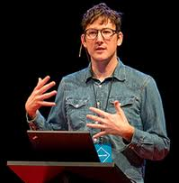


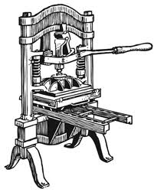
How we got to the stack…
JavaScript
V8
Node
Notes:
Discovery of Fire – Brenden Eich – JavaScript - what year?
The printing press - Lars Bak – creator of V8 – what year?
To the moon - Ryan Dahl – Node - what year?

Slide 6
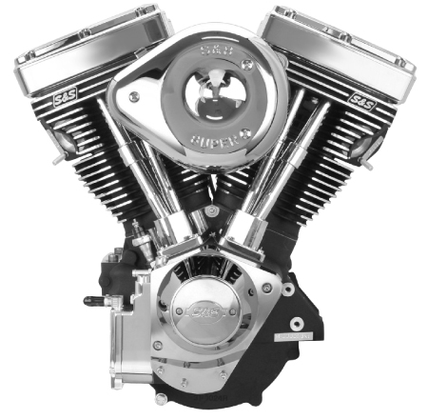
Engines
Notes:
Engines…..

Slide 7
SpiderMonkey
JavaScriptCore
Chakra - JScript
Rhino
Nashorn
But there is one more…
Notes:
SpiderMonkey – Mozilla – C/C++ - ships with Firefox
Rhino – Mozilla – Java – embedded into Java applications to provide scripting
JavaScriptCore (aka squirrell fish) – WebKit JS renderer… except for Chrome
Chakra – IE9 – allows for GPU, JIT compiles on a separate CPU core in parrallel with the browser
Nashorn – in Java 8

Slide 8

https://code.google.com/p/v8/
Notes:
V8 engine developed for Chrome
Written in C++ (funs standalone or embedded into a C++ program)

Slide 9
Fast Property Access
Dynamic Machine Code Generation
Efficient Garbage Collection
https://developers.google.com/v8/design
Notes:
V8 does not use dynamic lookup on properties – it creates Hidden Classes behind the scenes
Most engines use a dictionary lookup for properties
V8 creates hidden classes behind the scenes, v8 changes its hidden class when a property is added – THINK MAPS
That means a new hidden class is created for each new property…
The trick is that when you create a new instance of the same class it uses the hidden classes, not creating new ones
V8 compiles JavaScript directly into machine code when its first executed
V8 employs a “stop-the-world” approach to garbage collection:
This means program execution is stopped when garbage collection takes place
Process only part of the object heap to minimize impact on application
knows exact location of objects and pointers in memory
Object heap is divided into two parts,
space for new objects
old space for objects surviving garbage collection.

Slide 10

Server?
(aka not the browser)
Notes:
The Server…. And infrastructure.

Slide 11

http://nodejs.org/
Notes:
Node is influenced by Ruby EventMachine and Python Twisted
But Node is different it presents the event loop as a language construct and not a library
This is key as Node does not block on entering the Event Loop like the aforementioned influencers
HTTP is a first class protocol
You can have your CoffeeScript too… and TypeScript

Slide 12

https://npmjs.org/
Notes:
Node Package Manager
Npm install
Npm json –help

Slide 13
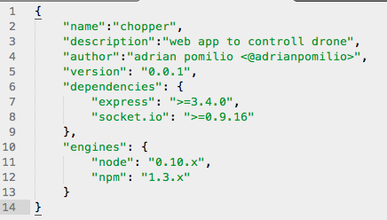
package.json
Notes:
Package.JSON file
Point out:
Engines
Dependencies
Using ‘x’ for 1.0.x
Talk about devDependencies and how its used for items you do not want installed in production. --- think tests

Slide 14
Note on versioning
1 . 2 . 3
1 – Major Version
2 – Minor Version
3 – Patch Version
List your dependencies via: 1.2.x
http://blog.nodejitsu.com/package-dependencies-done-right
Notes:
Package.JSON file
Point out:
Engines
Dependencies
Using ‘x’ for 1.0.x

Slide 15
“Abstraction is one of the greatest visionary tools ever invented by human beings to imagine, decipher, and depict the world.” Jerry Saltz
Node - http
Connect
Express
Notes:
It started with Node and creating an http server
Then Connect
Then Express
It is just a layer of abstraction to help you create a web server to build applications easier.
Jerry Saltz is a senior art critic, won a Pulitzer for Criticism

Slide 16

http://expressjs.com/
Notes:
Hapi js
Express 4 removes the connect middleware
The E in Mean Stack

Slide 17

Data
Notes:
Data – storage
Files, databases, etc…
Relational and NoSQL

Slide 18



Notes:
MongoDB
CouchDB
Redis
And More …

Slide 19

Workflows

Slide 20

http://yeoman.io/
Notes:
A workflow
A collection of tools and best practices

Slide 21
“A worflow; a collection of tools and best practices working in harmony to make developing for the web even better.”
Grunt
Bower
Yo
Notes:
Yo – is the scaffolding tool
Grunt – used to test and preview – they built special features into it
Bower – dependency management…

Slide 22



Task Runners
Notes:
GruntJS
Build tool
Task Runner – think ant, composer (maybe)
Gulp
Streams
Code over configuration
Broccoli
Filesystem is the API
Allows for chaining of plugins (Grunt does not)
Backend agnostic

Slide 23
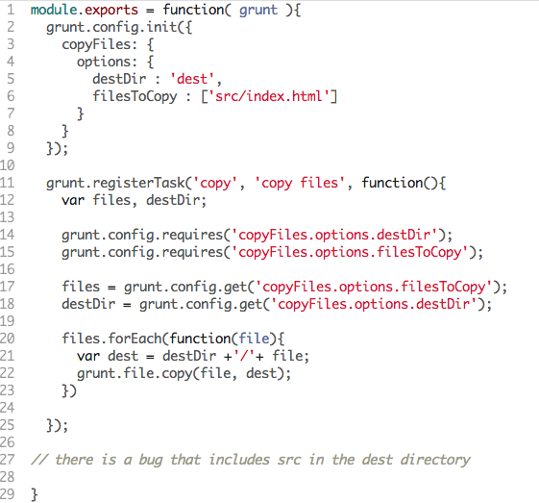
Gruntfile.js – copy task
Just use Grunt-copy-to task ☺
Notes:
Gulp –
Code over configuration
Uses STREAMS so it doesn’t write intermediary files to disk
Npm install –g gulp
Npm install –save-dev gulp
Create a gulpfile.js at the root of the project

Slide 24
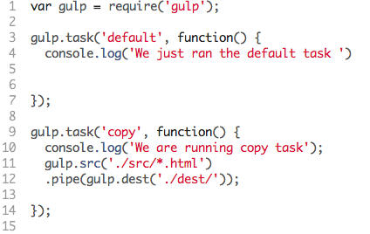
gulpfile.js – copy task
Notes:
Gulp –
Code over configuration
Uses STREAMS so it doesn’t write intermediary files to disk
BUT with streams PLUGINS have to worry about race conditions and deadlock
GULP has only 5 functions to learn
.src – creates a readable stream
.dest – creates a writable stream
Only provides streams and a basic task system
Npm install –g gulp
Npm install –save-dev gulp
Create a gulpfile.js at the root of the project

Slide 25

Client Package
Management
http://bower.io/
Notes:
Manage dependencies
Manages any package (JavaScript, CSS, HTML) any third party code

Slide 26
Bower is JUST a package manager
npm install –g bower
bower search …..
bower install …..
bower update …..
bower uninstall …..
bower ls / lookup / info / cache-clean
https://github.com/bower/bower
Notes:
To install it: npm install –g bower
Search: wo a keyword and you get all the packages, narrow it down with a package
Bower install jquery
Can include version numbers
Can install other things too
Install your own package: bower install ~/dev/mylibrary
Saves a copy to ~/.bower/<package>

Slide 27

Testing

Slide 28
Too huge for this preso!
Check out the testing sessions
http://lm.eways.ph/5bm
http://jster.net/category/testing-frameworks
Notes:
Protractor
Mocha
On and on
Test Runners vs Test Suites

Slide 29
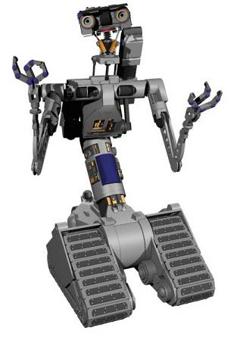
No disassemble!
JavaScript is alive!
Notes:
Hardware – JavaScript is showing up as a native language on many hardware devices, and there are dozens of ports going on.

Slide 30

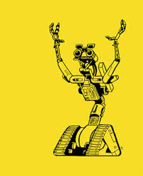
https://github.com/rwaldron/johnny-five
http://nodecopter.com
Notes:
Embedded systems
Flight
Robotics

Slide 31
Additional Information
Nodemon - https://github.com/remy/nodemon
Socket.IO - http://socket.io/
More V8 – http://www.youtube.com/watch?v=lZnaaUoHPhs
Rules Engine - https://npmjs.org/package/node-rules

Slide 32
Adrian Pomilio / @adrianpomilio / www.github.com/adrianpomilio / www.pomil.io

